Slide 1
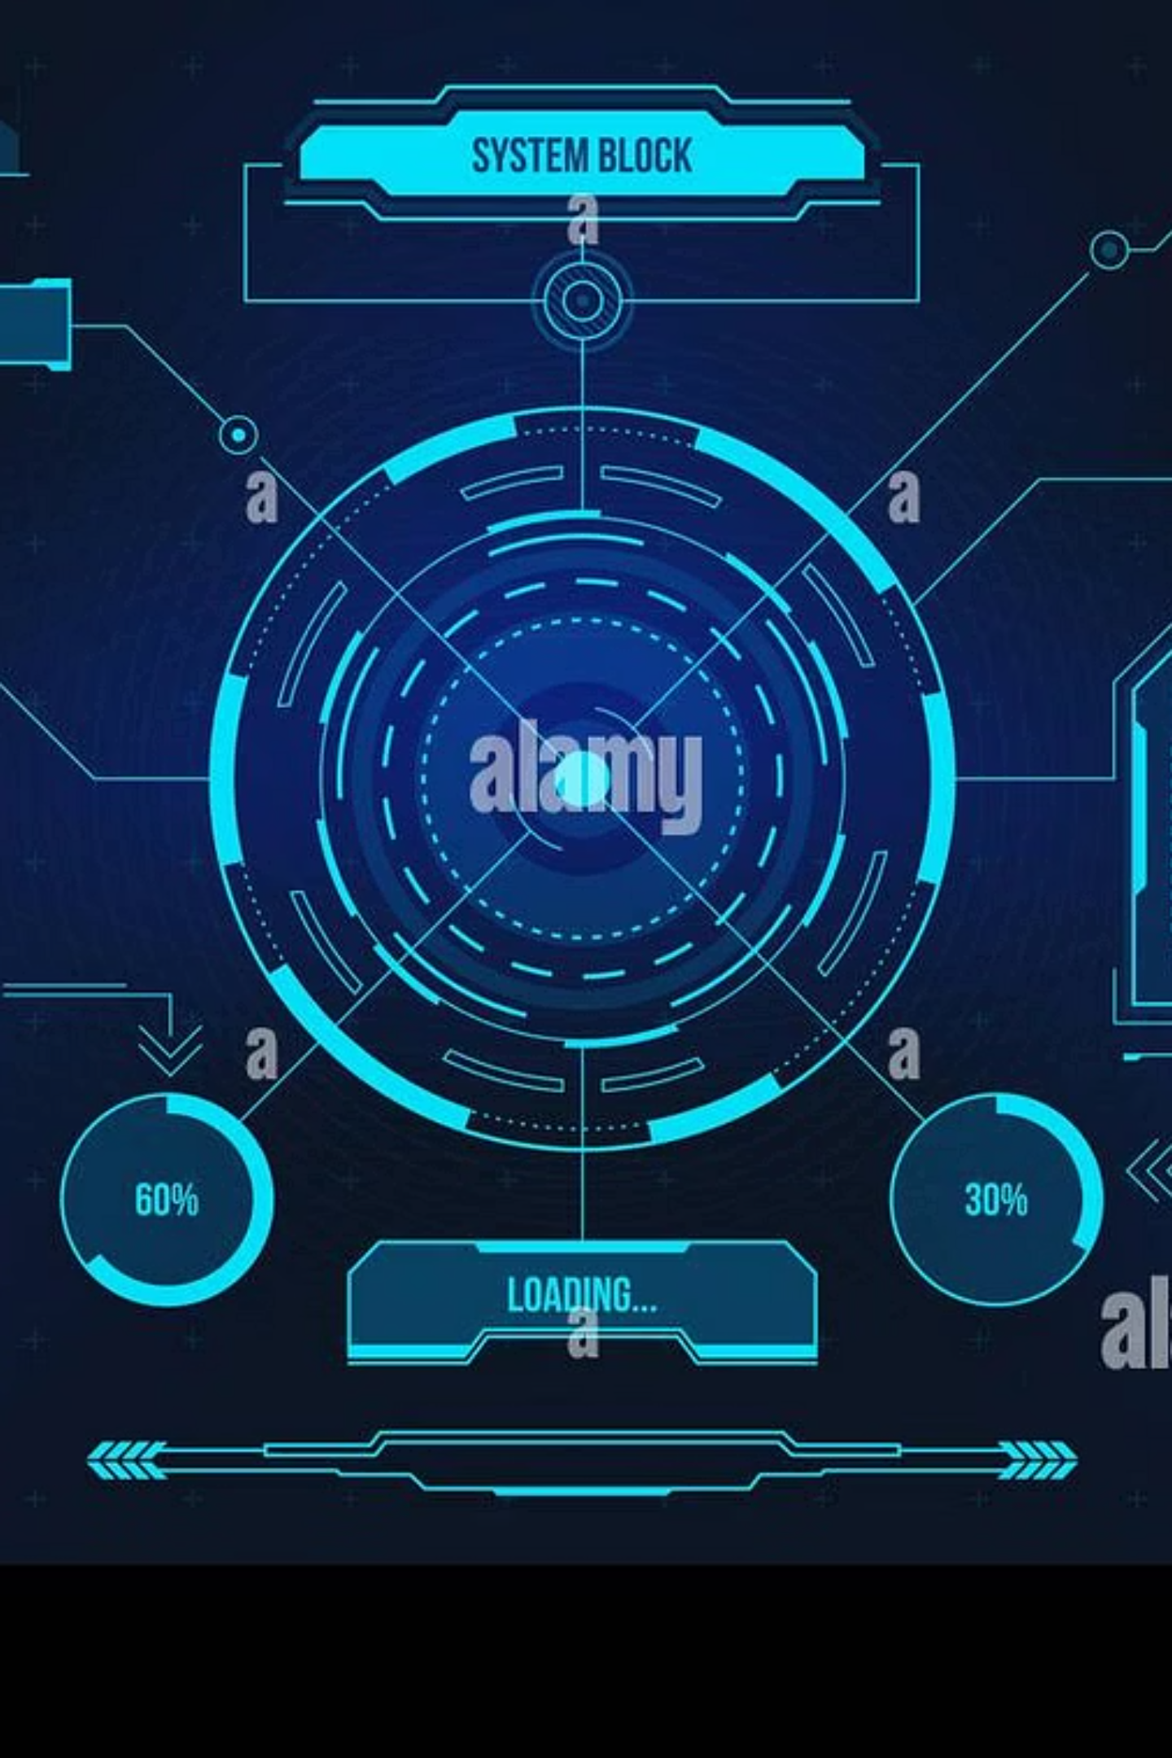
Ticket-to-Test AI
AGENTIC QA COPILOT
From Jira ticket to complete test suite within 5 minutes. Transform your QA workflow with autonomous AI agents that think, plan, and self-correct.
Team Name: QualityOps
Team Members: Sahil Chauhan
Sruti Daga
Yash Sharma

Slide 2

THE PROBLEM
QA Teams Are Drowning in Manual Work
The Real Cost
2-3 Hours
40-70%
$20 billion wasted annually on manual test case writing across the industry. QA bottlenecks slow releases while inconsistent quality creates risk.
Wasted per ticket writing test cases manually
Of QA time spent on repetitive documentation
Senior QA engineers become documentation machines instead of strategic quality leaders.
30% of Bugs
Reach production due to coverage gaps
Market opportunity: 5M+ QA engineers globally—every agile team faces this challenge.

Slide 3

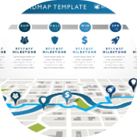
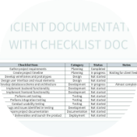
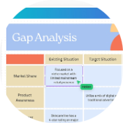
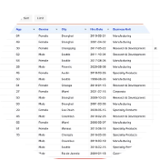

THE SOLUTION
One-Click Transformation
Jira/Azure DevOps ticket → 5 autonomous AI agents → production-ready test suite within 5 minutes
QA Execution Roadmap
Production-Ready Test Cases
Coverage Gap Analysis
Universal Export
Excel format compatible with Jira, Xray, Zephyr, and any test management tool
Comprehensive test strategy covering happy paths, negative testing, edge cases, and regression scenarios
Detailed steps, expected results, test data, and priorities—ready to execute immediately
AI identifies missing scenarios and generates clarification questions to ensure complete coverage
Time investment: 4-5 minutes generation + 5 minutes review = 95% time saved

Slide 4
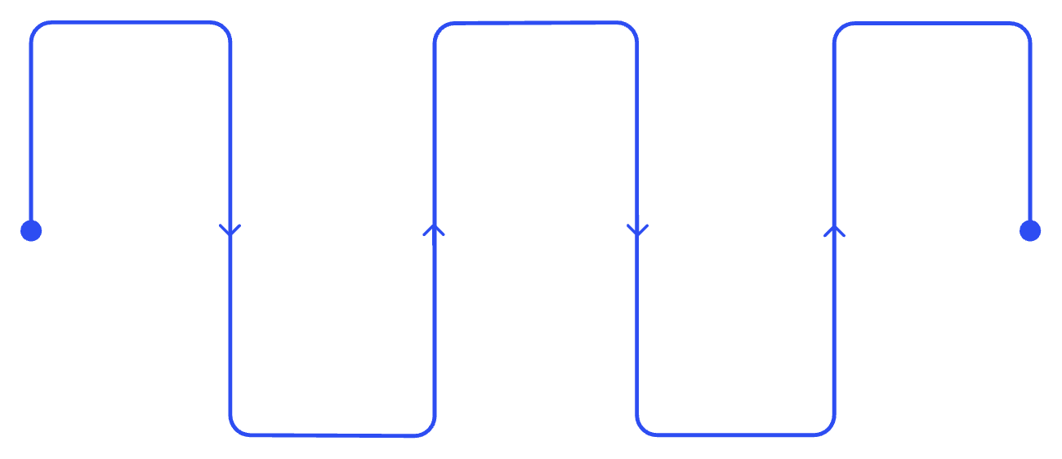




Truly Agentic Architecture
NOT JUST PROMPTING
Five Specialized Agents Working Autonomously
Ticket Reader
Test Strategist
Coverage Auditor
1
Extracts requirements and gaps
Creates roadmap and priorities
Validates coverage and self-corrects
Ticket Reader
Extracts requirements and identifies gaps autonomously
2
Context Builder
Maps impacted modules and dependency chains
Context Builder
Test Generator
Maps modules and dependencies
Produces detailed test cases
3
Test Strategist
Creates comprehensive QA roadmap by category
Autonomous Decision-Making
Goal-Driven
4
No human-in-the-loop required during execution
Focused on achieving complete test coverage
Test Generator
Self-Correcting
Stateful Memory
Produces detailed test cases with priorities
Auditor validates and loops back to improve quality
Agents build on each other's work collaboratively
5
Technology stack: LangGraph orchestration powered by Gemini 3.0 with structured JSON outputs for reliability
Coverage Auditor
Validates coverage, finds gaps, self-corrects

Slide 5

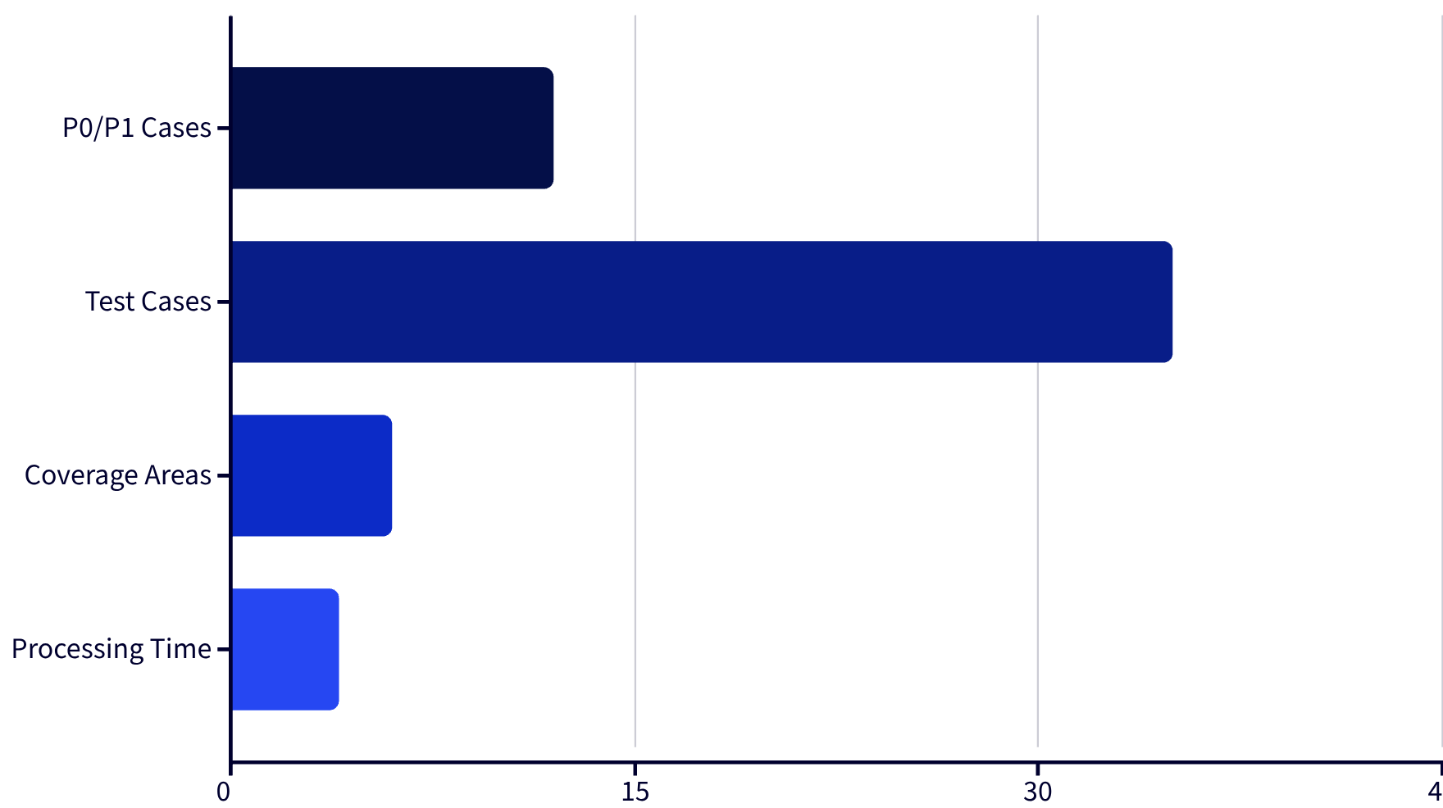
LIVE DEMO
Proven Performance
Real Results from Real Tickets
Our system generates 50-80 comprehensive test cases per ticket in just 4-5 minutes. Each suite includes 8-12 critical path scenarios and covers 5-7 distinct testing categories.
Production-ready accuracy: 85-90% of generated test cases require minimal or no editing before execution.
Full End-to-End System
Streamlit Interface
Real-Time Tracking
Professional Export
Completely functional and tested
Intuitive web-based UI
Watch agents work autonomously
Excel format for any tool
Sample Tickets
Deploy Today
Bug, feature, and API scenarios
Production-ready infrastructure

Slide 6

Measurable Business Impact
ROI ANALYSIS
95%
125
$81K
6,671%
Time Reduction
Hours Saved
Annual Savings
Return on Investment
From 2-3 hours to 9 minutes per ticket
Per sprint for a 5-person QA team
Per team after API costs
First-year ROI including implementation
Quality Improvements
30%
40%
100%
Test Coverage Increase
Defect Leakage Reduction
Team Consistency
AI discovers edge cases humans miss
Better coverage prevents production bugs
Standardized format across all QA engineers
5-Person Team Economics
50 tickets per sprint — typical agile velocity
$6,250 saved per 2-week sprint at $50/hour loaded cost
$1,200 annual API costs — negligible compared to savings
Value from day one — no training period required

Slide 7



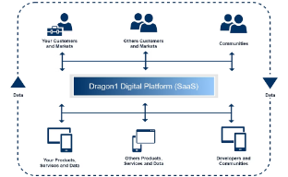
Strategic Roadmap
MARKET FIT & FUTURE
Target Market: 5M+ QA Engineers Globally
Fintech
Healthcare
E-Commerce
Enterprise SaaS
Regulatory compliance and risk testing requirements
FDA documentation and validation standards
High-velocity releases with zero downtime
Complex integration and multi-tenant scenarios
Future Innovation Pipeline
Q1: Seamless Integration
1
Auto-sync with Jira/Azure DevOps—one-click deployment
2
Q2: Marketplace Launch
Atlassian and Microsoft marketplace listings
Q3: Auto-Execution
3
Selenium/Playwright integration for end-to-end automation
4
Q4: Predictive Quality
AI-powered risk analytics and self-healing tests
Mission: Transform QA engineers from documentation machines into strategic quality leaders who focus on high-value testing and innovation.

Slide 8
THANK YOU !!
Ticket-to-Test AI · Streamlit

